Slide 1
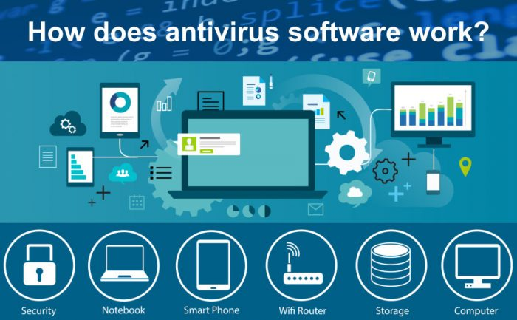
Unit - 4

Slide 2
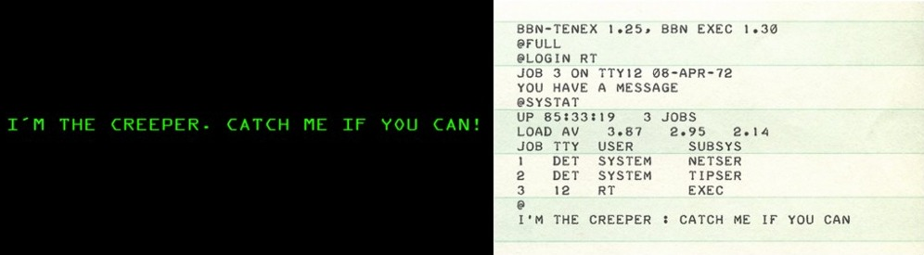
Virus
In 1971, the first virus was created. It was named as the ‘Creeper Virus.’
It spread through the Advanced Research Projects Agency Network (ARPANET), which was the world’s first digital networking communications method.

Slide 3

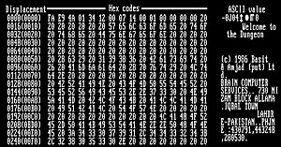
Virus
Creeper virus was finally defeated by a program called The Reaper. Ray Tomlinson created it.
The first-ever true antivirus is “The Reaper.”
American computer scientist Frederick B. Cohen coined the term ‘Virus’ in 1983.
The first computer virus, “Brain” affects the boot sector. Created in early 1986.

Slide 4
Antivirus
Antivirus software is a program designed to protect computers and digital devices from malicious software, or malware.
Its main function is to detect, prevent, and remove various forms of malware, such as viruses, worms, trojan horses, ransomware, and spyware.
These malicious programs can compromise the security, performance, and functionality of a device, as well as steal sensitive data and facilitate cybercrimes.

Slide 5
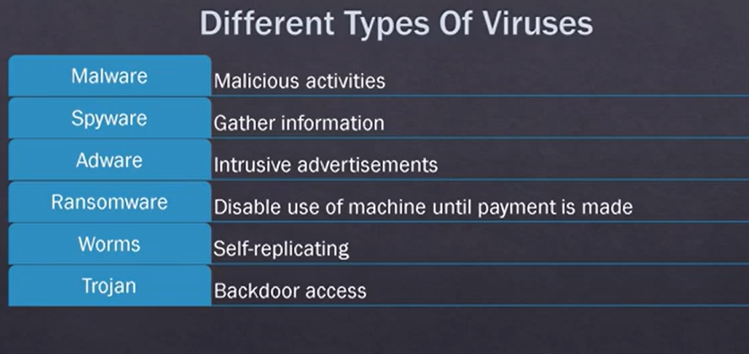
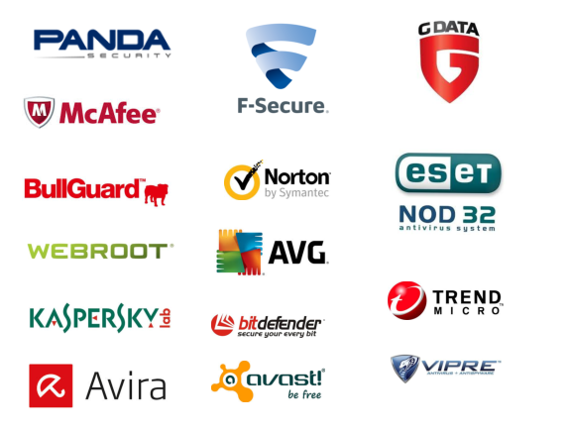
Types of virus

Slide 6
Features of Antivirus Software
Background Scanning
Antivirus software helps to scan all the applications, files, and programs that are opened from the backend. This process is called an on-access scanning.
Complete System Scans
Full system scans are by and large not really vital when you have an on-access scanning system in hand.
Full system scans become indispensable when an antivirus software is installed for the first time or if the antivirus software is not been updated with new virus definitions recently.

Slide 7
Features of Antivirus Software
Virus Definitions
Antivirus software functions based on the virus definitions to recognize if the file/program is genuine or malware intended.
That is the main reason to archive on the new virus definitions.
The virus definitions stashes the signatures of any viruses that as been categorized as infectious in the wild.
In the event that the antivirus software checks any application or file and that it finds the document infected by a malware that looks similar to the malware in the malware definition, then that file or program is stopped from executing, and then it is moved into the quarantine.

Slide 8
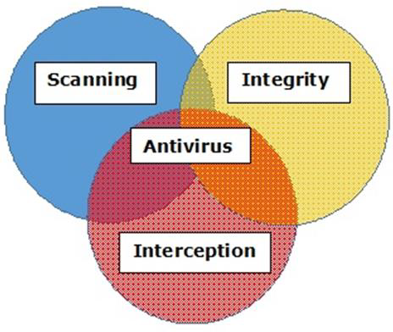
Basic Functions of Antivirus Engines
All antivirus engines have three components to function.
Scanning − When a new virus is detected in the cyberspace, antivirus producers start writing programs (updates) that scan for similar signature strings.
Integrity Checking − This method generally checks for manipulated files in OS from viruses.
Interception − This method is used basically to detect Trojans, and it checks the request made by the operating system for network access.

Slide 9
key components and processes
Signature-based detection
Antivirus programs use a database of known malware signatures, which are unique patterns or characteristics of specific malware.
The software continuously scans files and processes on a device, comparing them against the signatures in the database.
If a match is found, the antivirus flags the file or process as malicious and takes appropriate action, such as quarantining or deleting it.

Slide 10
key components and processes
Heuristic analysis
This method involves identifying malware based on its behavior or code structure, rather than relying on specific signatures.
Heuristic analysis can detect new or previously unknown malware by analyzing suspicious activities, such as attempts to access sensitive data or modify system files.
If the software detects potentially malicious behavior, it can block the process and alert the user.

Slide 11
key components and processes
Sandbox
Some antivirus software includes a sandbox feature, which isolates suspicious files or applications in a safe, virtual environment.
This allows the software to observe the behavior of the potential malware without risking harm to the actual device.
If the sandbox analysis determines the file or application to be malicious, the antivirus takes appropriate action.

Slide 12
key components and processes
Real-time protection
Antivirus software often runs in the background, continuously monitoring for potential threats.
This includes scanning incoming and outgoing data, such as email attachments, downloaded files, and website content.
Real-time protection helps to detect and block malware.

Slide 13
Types of scan
On-demand Scan
User wants to scan
specified time
Searches the contents of the disks, directories, and files and boot sectors and system components
Real-time Protection
Automatic protection
Runs in background (background guard)
Catches before it does damage
Monitor suspicious activity in real-time while data is loaded into the active memory. For example, when a USB drive is inserted, or a downloaded file is executed.
Smart scans
Scans the selected files
Scanning lowers the need of system resources while protecting against the more common types of viruses, threats, and risks.

Slide 14
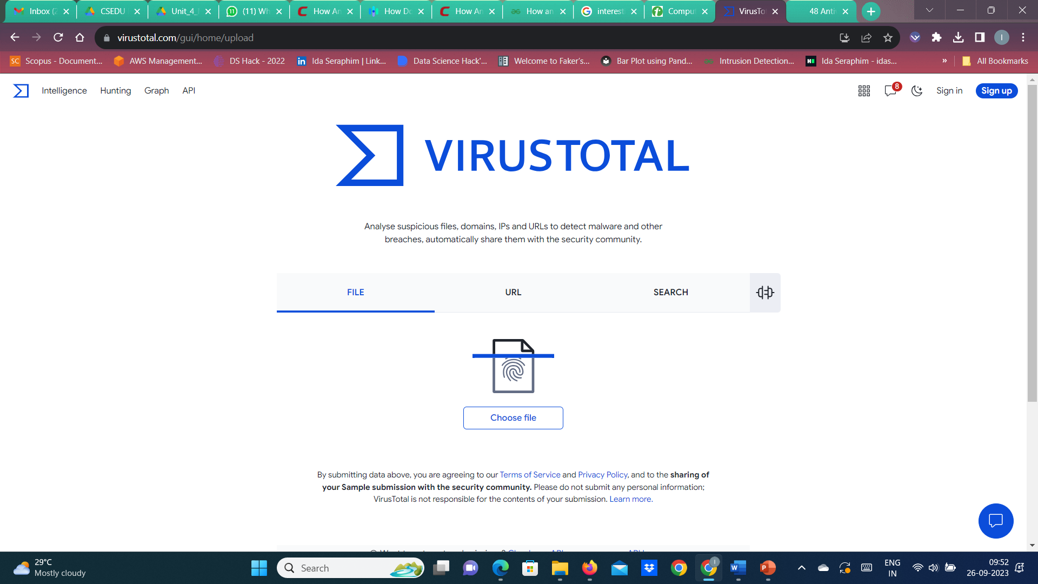
Online Virus Testing
https://virustotal.com/.
Free Antivirus Software
http://www.pcmag.com/article2/0,2817,2388652,00.asp
You can get a review which are the best top-rated free antiviruses at the moment.

Slide 15
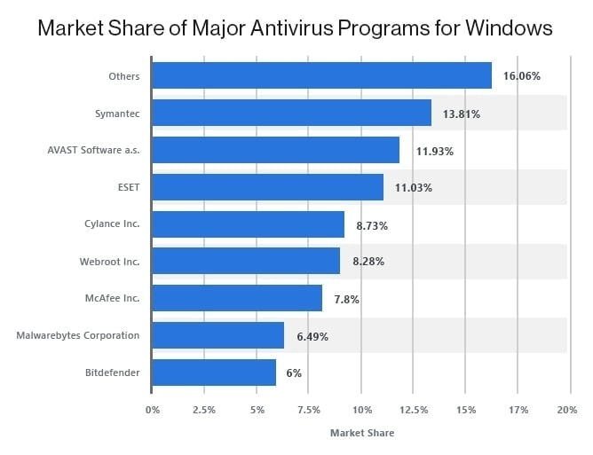
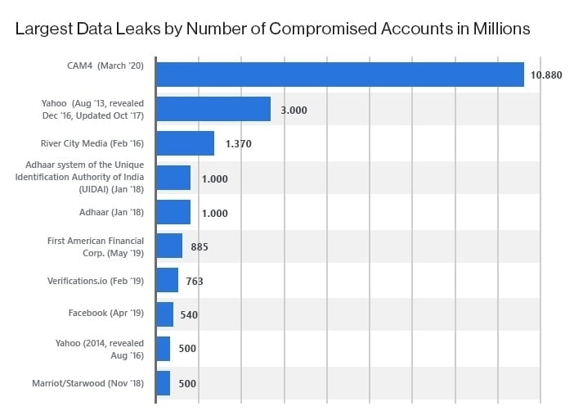
Antivirus and Cybersecurity Statistics 2023

Slide 16
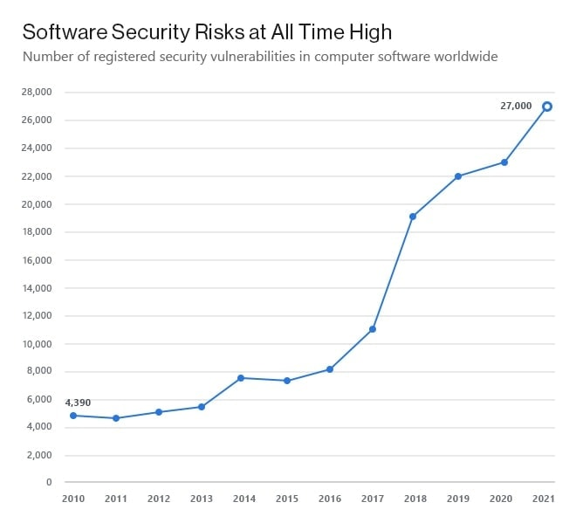
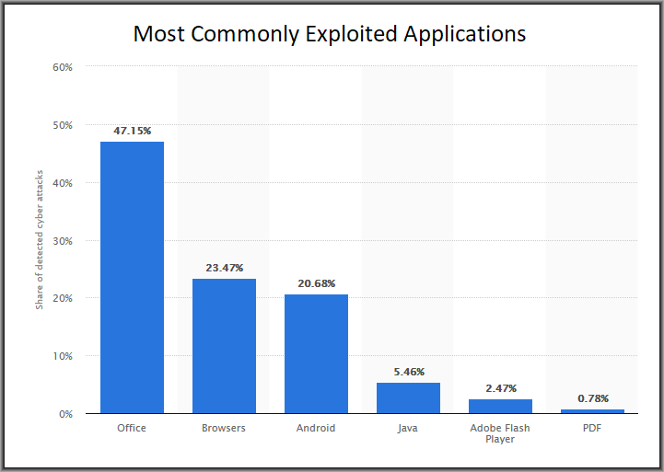
Antivirus and Cybersecurity Statistics 2023

Slide 17
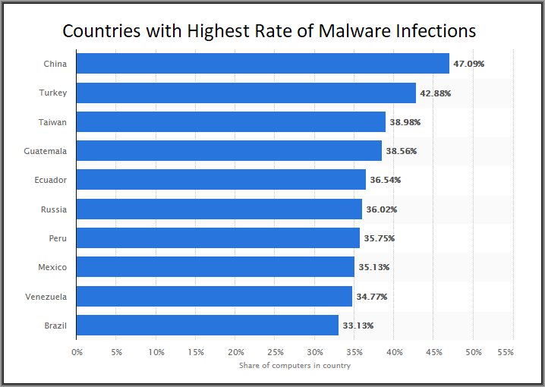
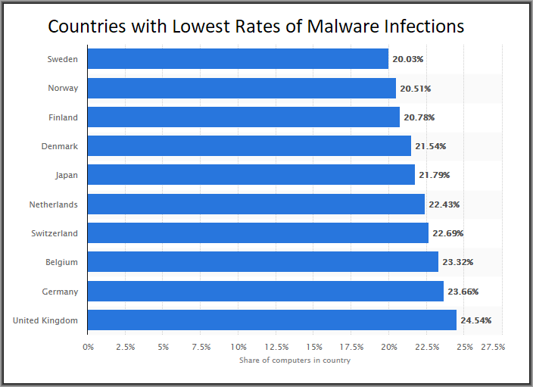
Antivirus and Cybersecurity Statistics 2023

Slide 18
Antivirus database updates
Regular antivirus database updates are crucial for maintaining the effectiveness of antivirus software in detecting and preventing malware infections.
Emergence of new malware
Cybercriminals continuously create and modify malware to evade detection and exploit new vulnerabilities.
Antivirus databases must be updated regularly to include the latest malware signatures and behavioral patterns, ensuring that the software can identify and block these emerging threats.

Slide 19
Antivirus database updates
Improved detection rates
Regular database updates help antivirus software maintain high detection rates and stay up to date with the latest malware variants.
An outdated database may not recognize new threats, leaving a device vulnerable to infections and potential damage.
Reduced false positives
As antivirus databases are updated, they often include refinements to existing signatures and heuristics.
This can help reduce false positives, where legitimate files or applications are mistakenly flagged as malicious.
Keeping the database current ensures more accurate detection and minimizes disruptions to the user.

Slide 20
Antivirus database updates
Protection against evolving tactics
Cybercriminals often develop new techniques to bypass antivirus software, such as using encryption, obfuscation, or other methods to hide their malware.
Regular updates help the antivirus software adapt and improve its detection capabilities in response to these evolving tactics.

Slide 21
Consequences of not updating the antivirus database
Increased vulnerability
An outdated database may not recognize new or modified malware, leaving a device susceptible to infections that can compromise security, performance, and data integrity.
Loss of sensitive data
Decreased Detection Rates
If your antivirus is not updated, it won't have the latest virus definitions, making it less effective in detecting and removing newer malware strains.
This can result in increased vulnerability to emerging threats.

Slide 22
Consequences of not updating the antivirus database
Inadequate Protection
New types of malware, including viruses, ransomware, and other malicious software, are continuously being developed by cybercriminals.
If your antivirus is not updated, it may not be equipped to recognize and defend against these new threats. This leaves your system exposed and at a higher risk of infection.
System Performance Issues
Antivirus updates not only include new virus definitions but also often include improvements in performance and efficiency.
Skipping updates may result in slower scan times, higher resource usage, and overall reduced performance of the antivirus software.

Slide 23
What is a credential attack?
It refers to various techniques and methods used by malicious actors to gain unauthorized access to a Windows-based computer system or network by stealing or exploiting user credentials.
These credentials may include usernames and passwords, security tokens, or other forms of authentication information.

Slide 24
Types of attack
Password Guessing or Brute Force Attacks: Attackers attempt to guess or crack user passwords by trying different combinations until they find the correct one. This can be time-consuming but is effective if the password is weak.
Dictionary Attacks: Similar to brute force attacks, but instead of trying every possible combination, attackers use a pre-compiled list of common passwords and phrases to guess the target user's password.
Phishing: Attackers send deceptive emails, messages, or websites that trick users into revealing their login credentials. Once the user enters their information, the attacker captures it.

Slide 25
Types of attack
Keyloggers: Malware or hardware devices are used to record the keystrokes of users, thereby capturing their usernames and passwords when they log in.
Pass-the-Hash Attacks: Instead of stealing actual passwords, attackers capture password hashes (a one-way representation of a password) and use these hashes to authenticate themselves without knowing the actual password.
Pass-the-Ticket Attacks: Attackers capture Kerberos tickets (authentication tokens) from one user and use them to impersonate that user and access network resources.

Slide 26
Types of attack
Credential Dumping: Attackers exploit vulnerabilities in Windows systems to extract credentials stored in memory, such as LSASS (Local Security Authority Subsystem Service), which can be used for further attacks.
Credential Stuffing: Attackers use lists of known usernames and passwords obtained from previous data breaches to try those same combinations on other services and systems where users may have reused their credentials.

Slide 27
Credential Stuffing
An attacker obtains leaked credentials (i.e., a username and password pair) from prior cyberattacks.
The attacker uses a software tool to automate the testing of stuffing these credentials against various websites and mobile applications.
If a credential set is successfully authenticated, then it is flagged as a valid account.
The attacker can now take over the account and extract any value, including personally identifiable information, credit card information, and stored value (such as loyalty points), as well as access email, make fraudulent purchases, and resell the account.

Slide 28
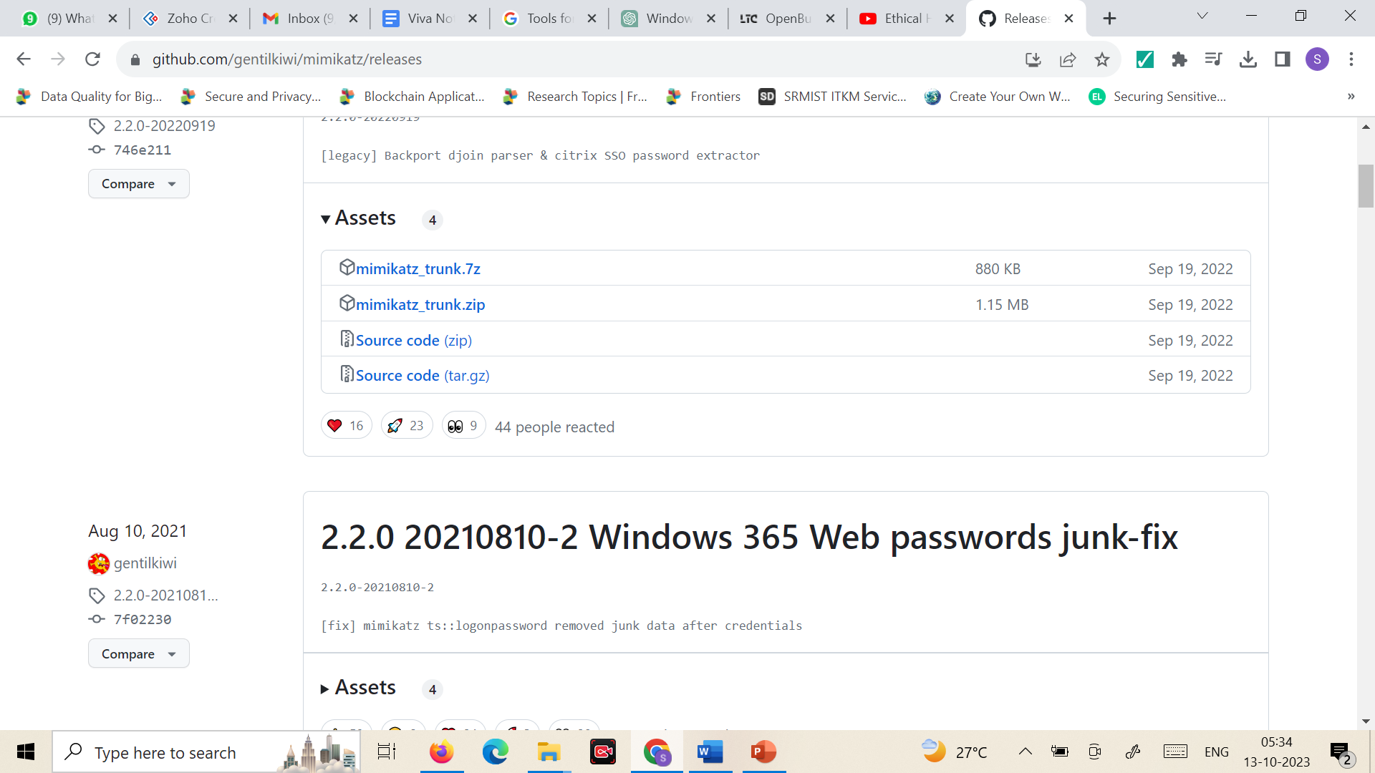
Mimikatz
https://github.com/gentilkiwi/mimikatz/releases

Slide 29
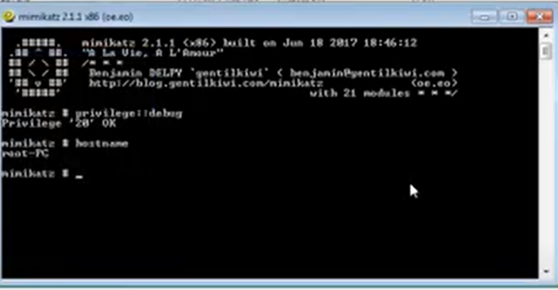
How to get the password?
Run the mimikatz app
privilege::debug
Enter hostname
Sekurlsa::logonpasswords

Slide 30
Key loggers
It’s spyware or surveillance software that tracks all the activities of the used.
It can record keystrokes, and take screenshots.
It also records internet history.
It can be installed on
Windows
Linux
Mac
Android

Slide 31
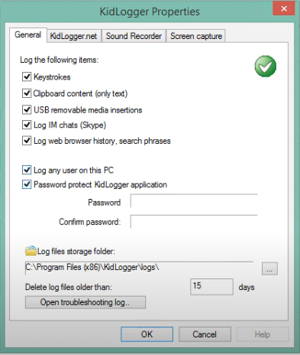
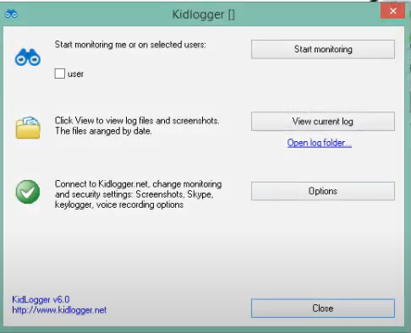
kidlogger
http://kidlogger.net/download.html

Slide 32
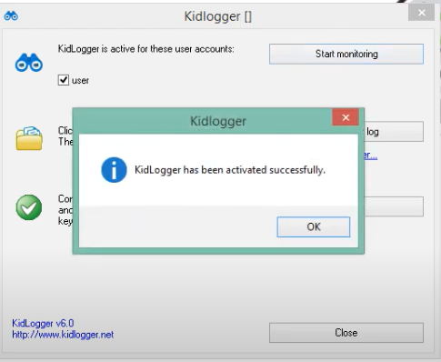
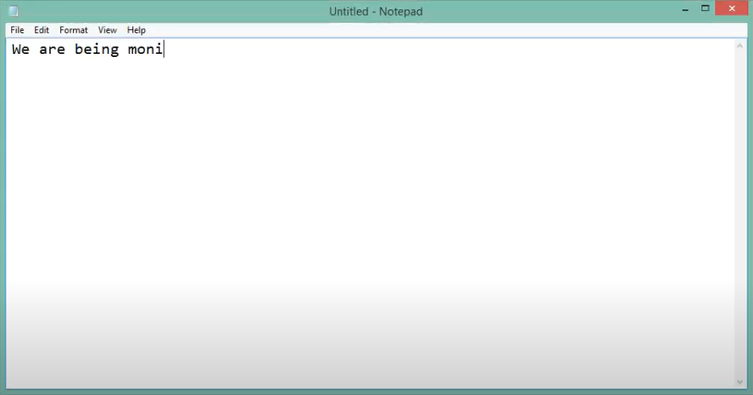
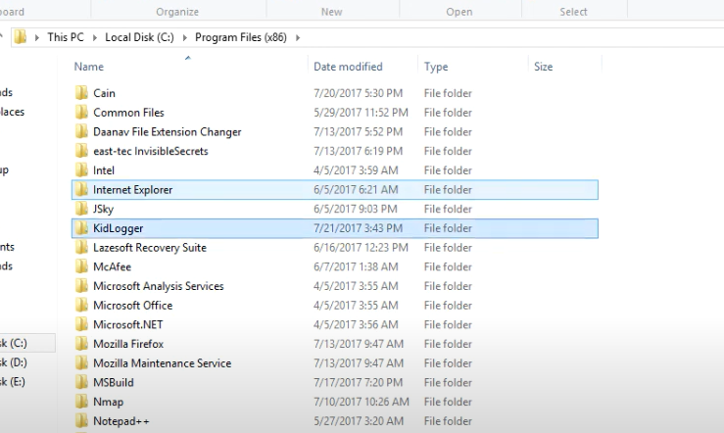
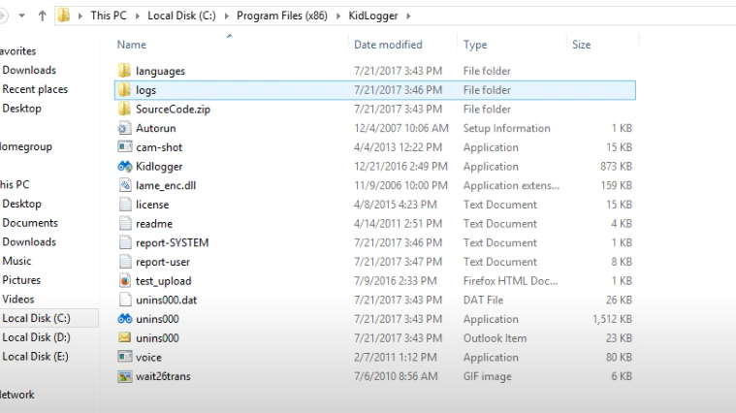
kidlogger

Slide 33
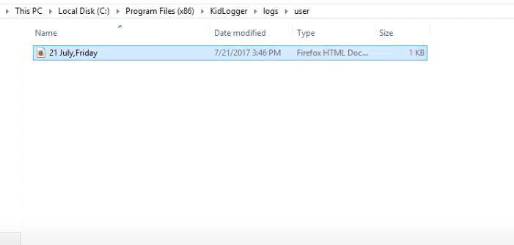
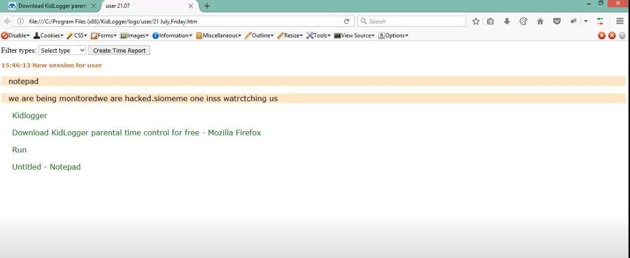
kidlogger

